Slide 1
Takeaway.com operates in different countries with different brands. Although the brand is different, they use mainly two different layouts, we call them the German group and the English group
We need to crawl all reviews (details on the following pages) from all countries, using the respective URL
We want to crawl the reviews daily, so we need a date parameter in order to get only the new reviews
The crawler should be in a docker to make the call by entering the URL and date parameter

Slide 2
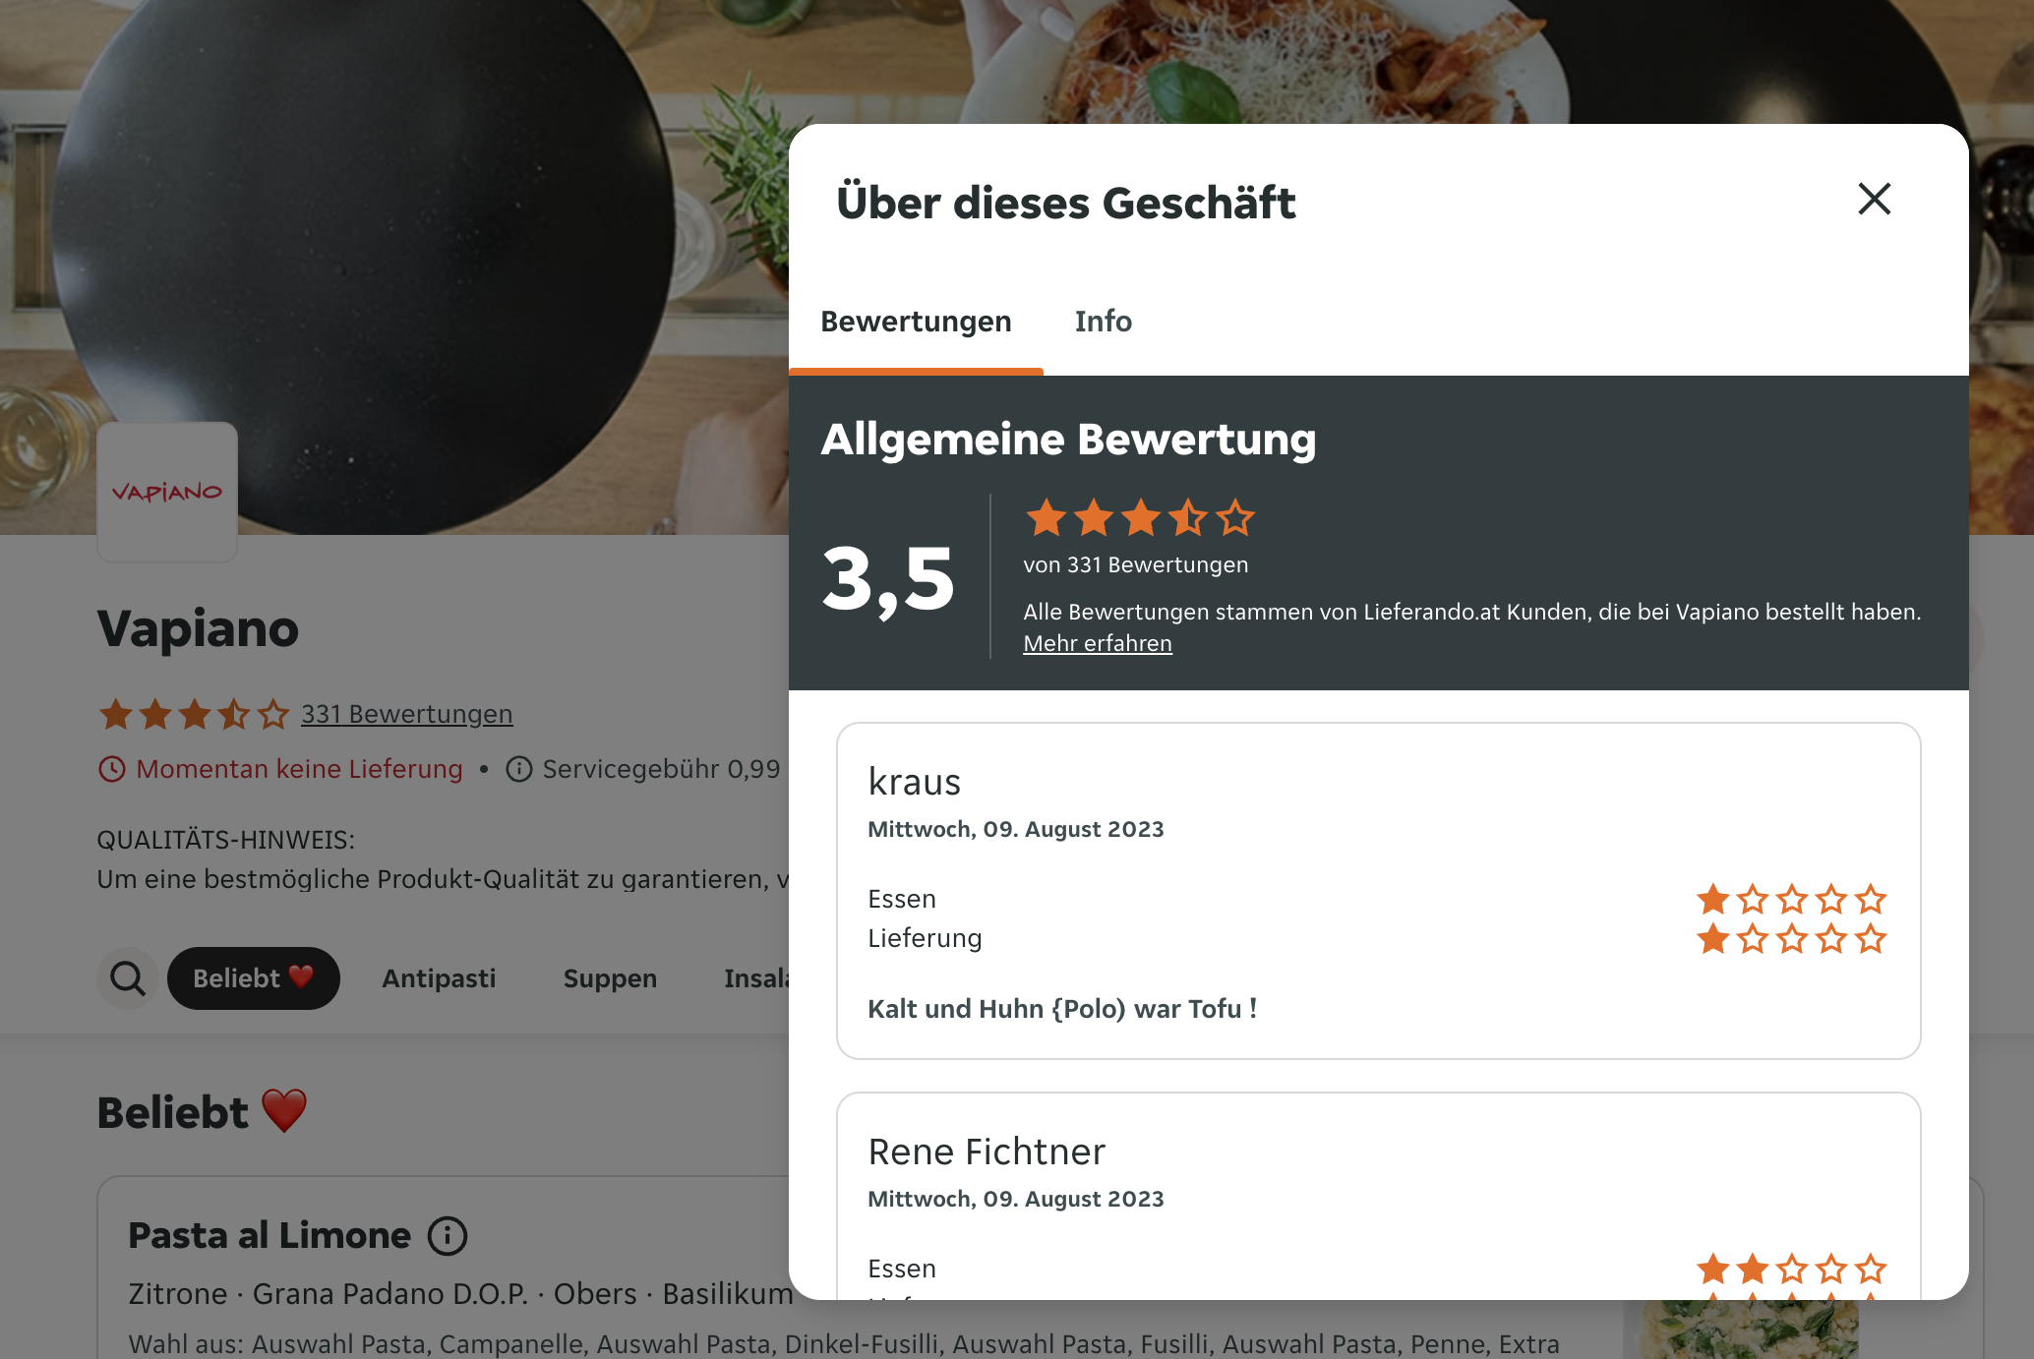
German group (crawler needs to work with all the countries below)
Austria: https://www.lieferando.at/speisekarte/vapiano-wien-herrengasse
Germany: https://www.lieferando.de/speisekarte/peter-pane-hamburg-goldbekplatz
Netherlands: https://www.thuisbezorgd.nl/de/speisekarte/vapiano-rembrandtplein
Poland: https://www.pyszne.pl/menu/vapiano-galeria-mokotow
Switzerland: https://www.just-eat.ch/en/menu/vapiano-zuerich-raemistrasse
overall rating
number of reviews
Each and every review in all languages including:
ID
Name
Date
Rating Food
Rating Delivery
Review text
URL of the review or review page (if available)
Add a date parameter so that we can crawl only the latest ones

Slide 3
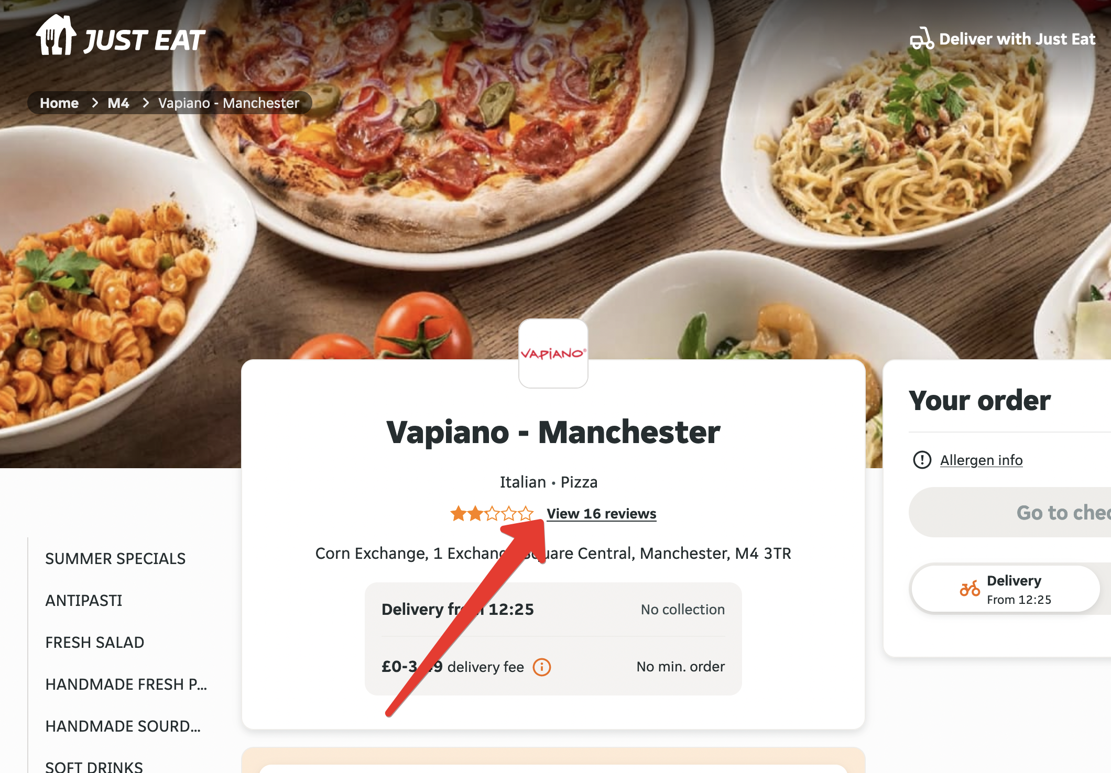
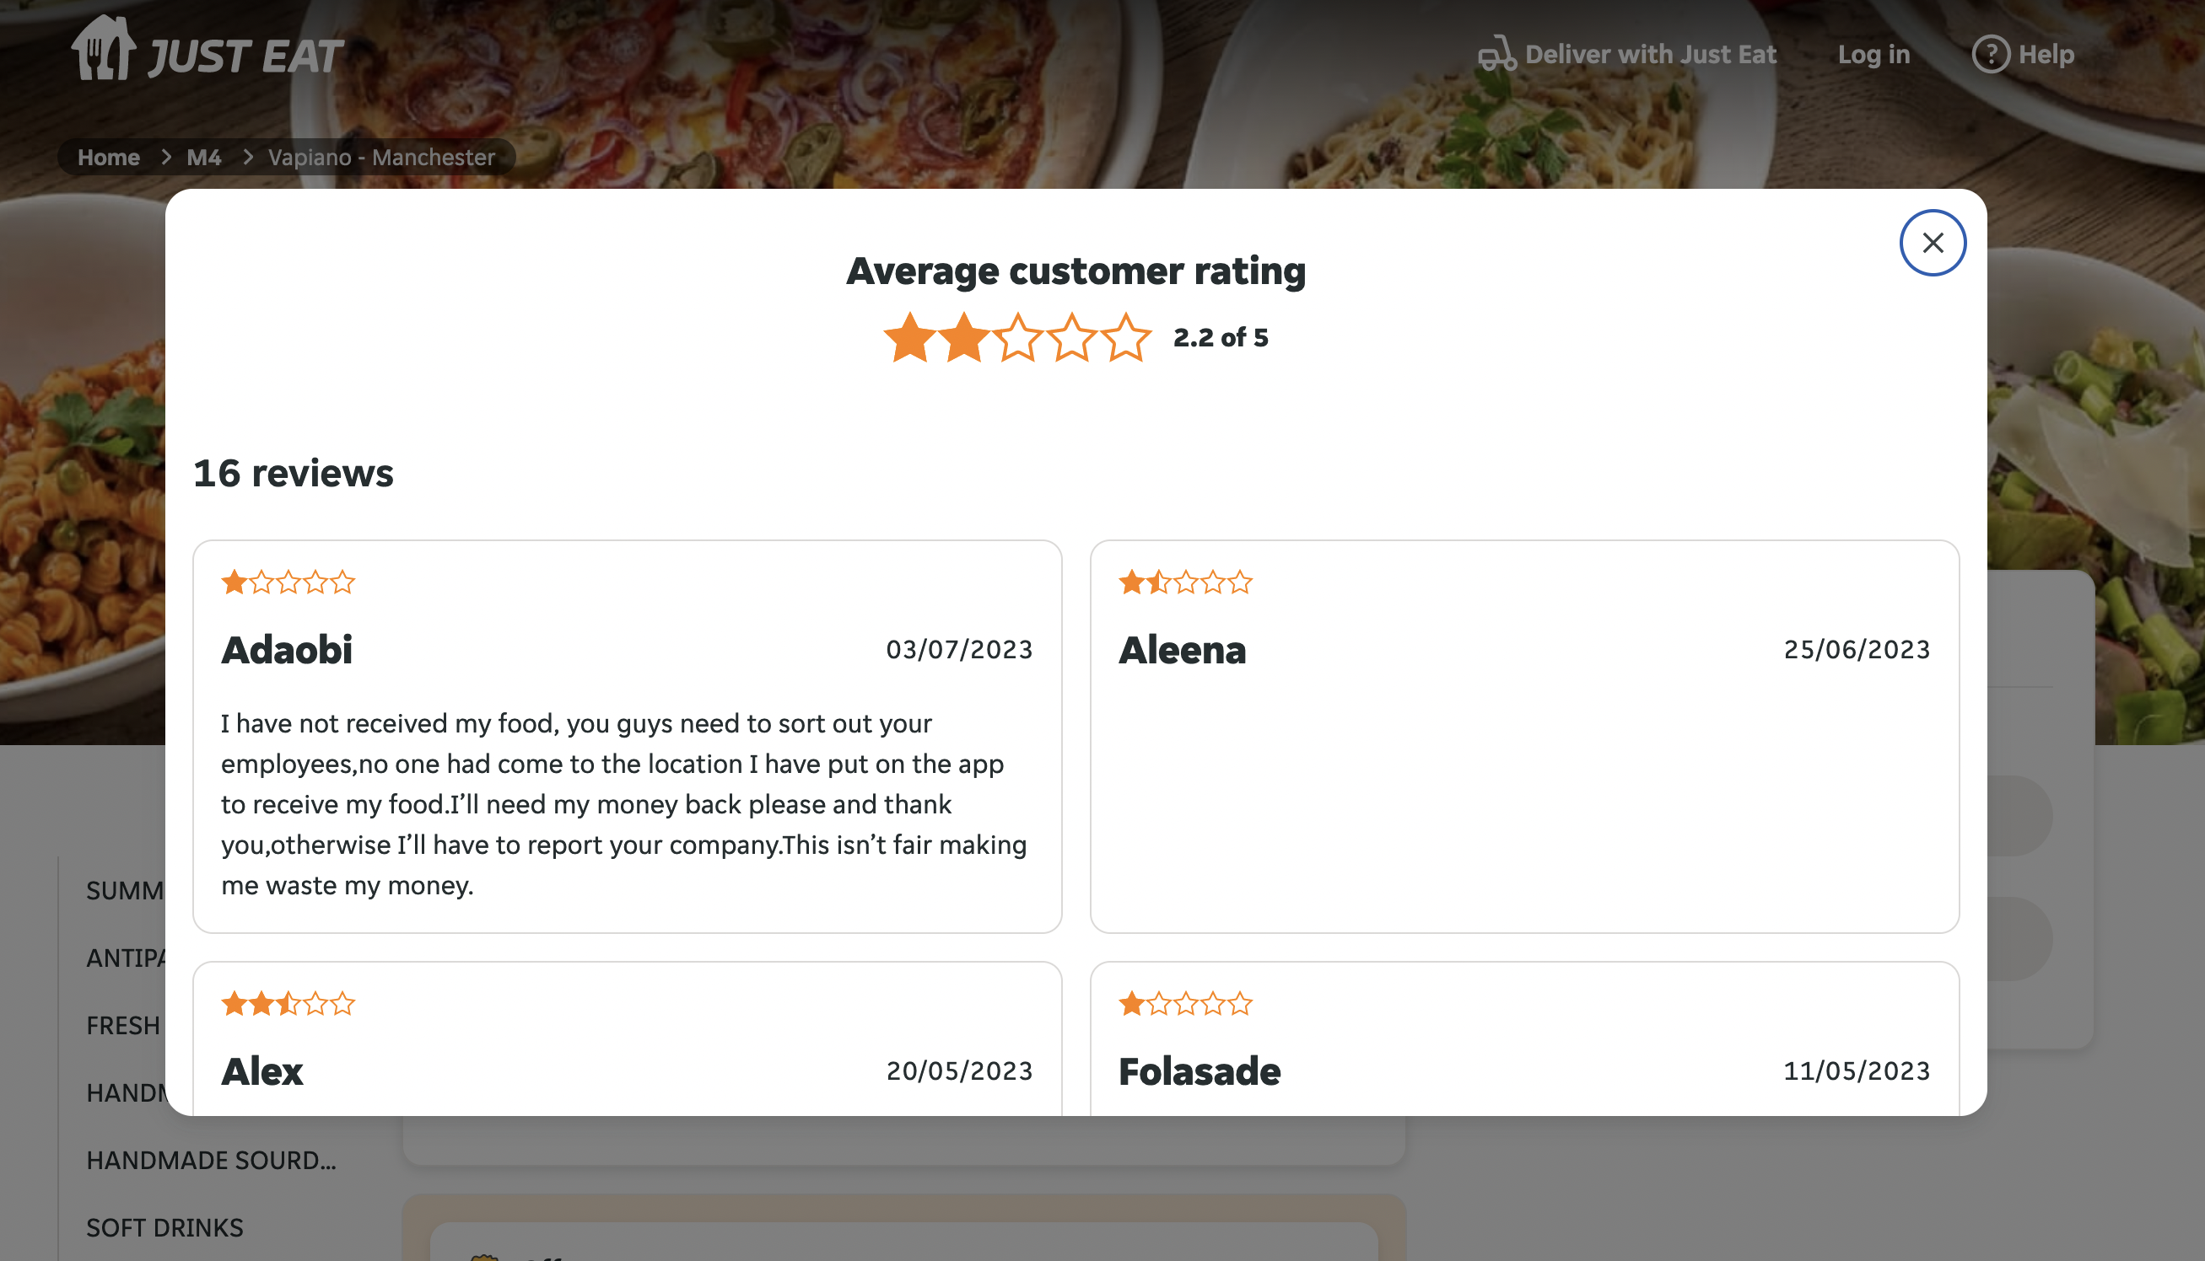
English group (crawler needs to work with all the countries below)
England: https://www.just-eat.co.uk/restaurants-vapiano-manchester/
Spain: https://www.just-eat.es/restaurants-vapiano-barcelona/
Australia: https://www.menulog.com.au/restaurants-vapiano-king-st-sydney/
overall rating
number of reviews
Each and every review in all languages including:
ID
Name
Date
Rating Food
Rating Delivery
Review text
URL of the review or review page (if available)
Add a date parameter so that we can crawl only the latest ones

